Slide 1
Modbus
Heansuh Lee and Shihab Ud Doula

Slide 2
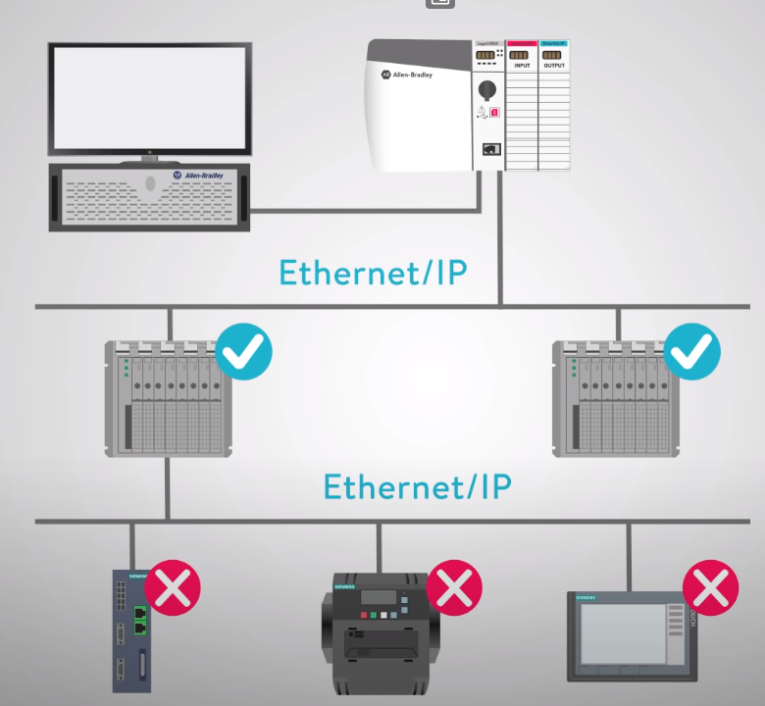

Motivation
Images references:
[1] https://www.youtube.com/watch?v=txi2p5_OjKU
[2] https://www.amazon.com/James-Daniel-Craig-Poster-Photo/dp/B01DJSCW6O

Slide 3
Agenda
History of Modbus
Concept, Topology and Applications of Modbus
Simulation of Modbus
Real-life Applications of Modbus
Evaluation of Modbus

Slide 4


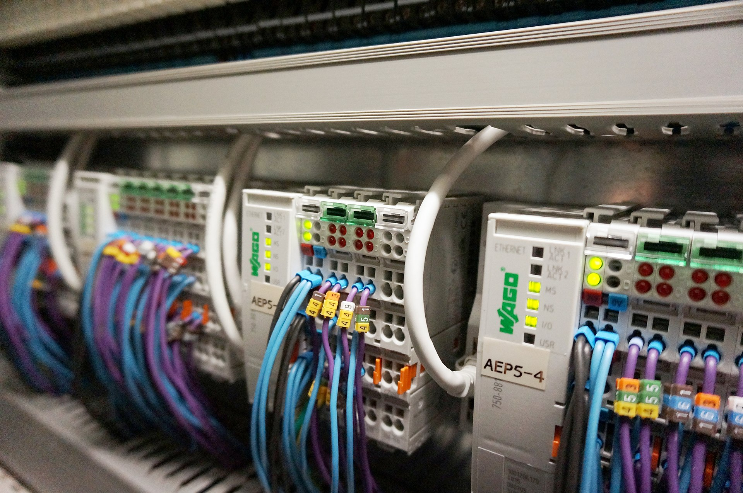
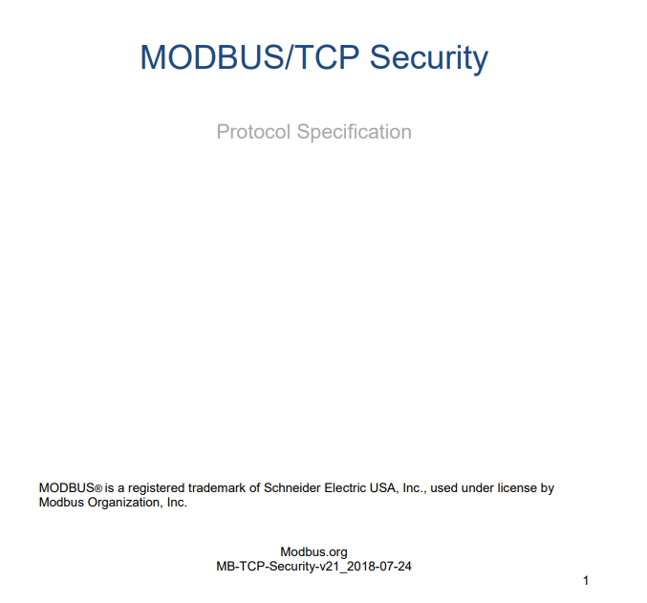

History
1998
1978
First with industrial PLCs!
2018
2004
Image references:
[1] https://rspsupply.com/images/content/Modicon%20logo.jpg
[2] https://en.wikipedia.org/wiki/Programmable_logic_controller#/media/File:Automate_industriel_WAGO_pour_un_syst%C3%A8me_de_monitoring_en_industrie_pharmaceutique.jpg
[3] https://modbus.org/docs/ModbusNews_Summer05.pdf
[4] https://modbus.org/docs/MB-TCP-Security-v21_2018-07-24.pdf

Slide 5
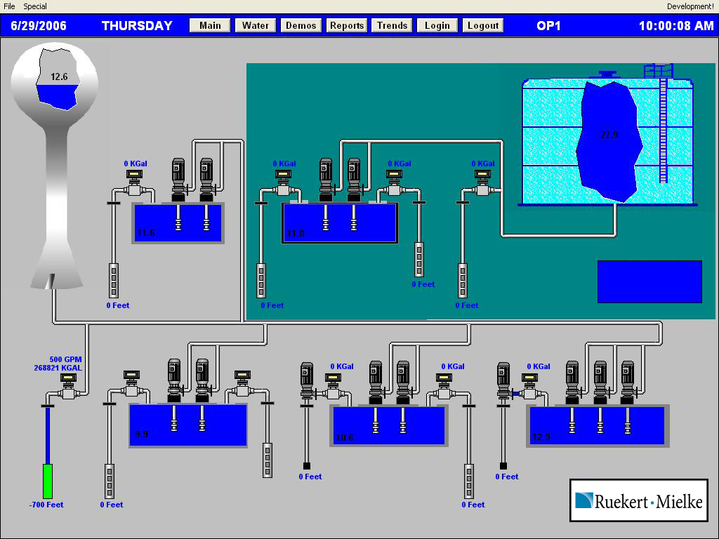
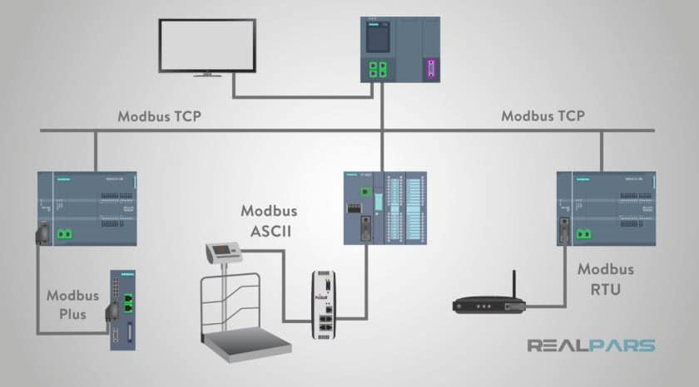
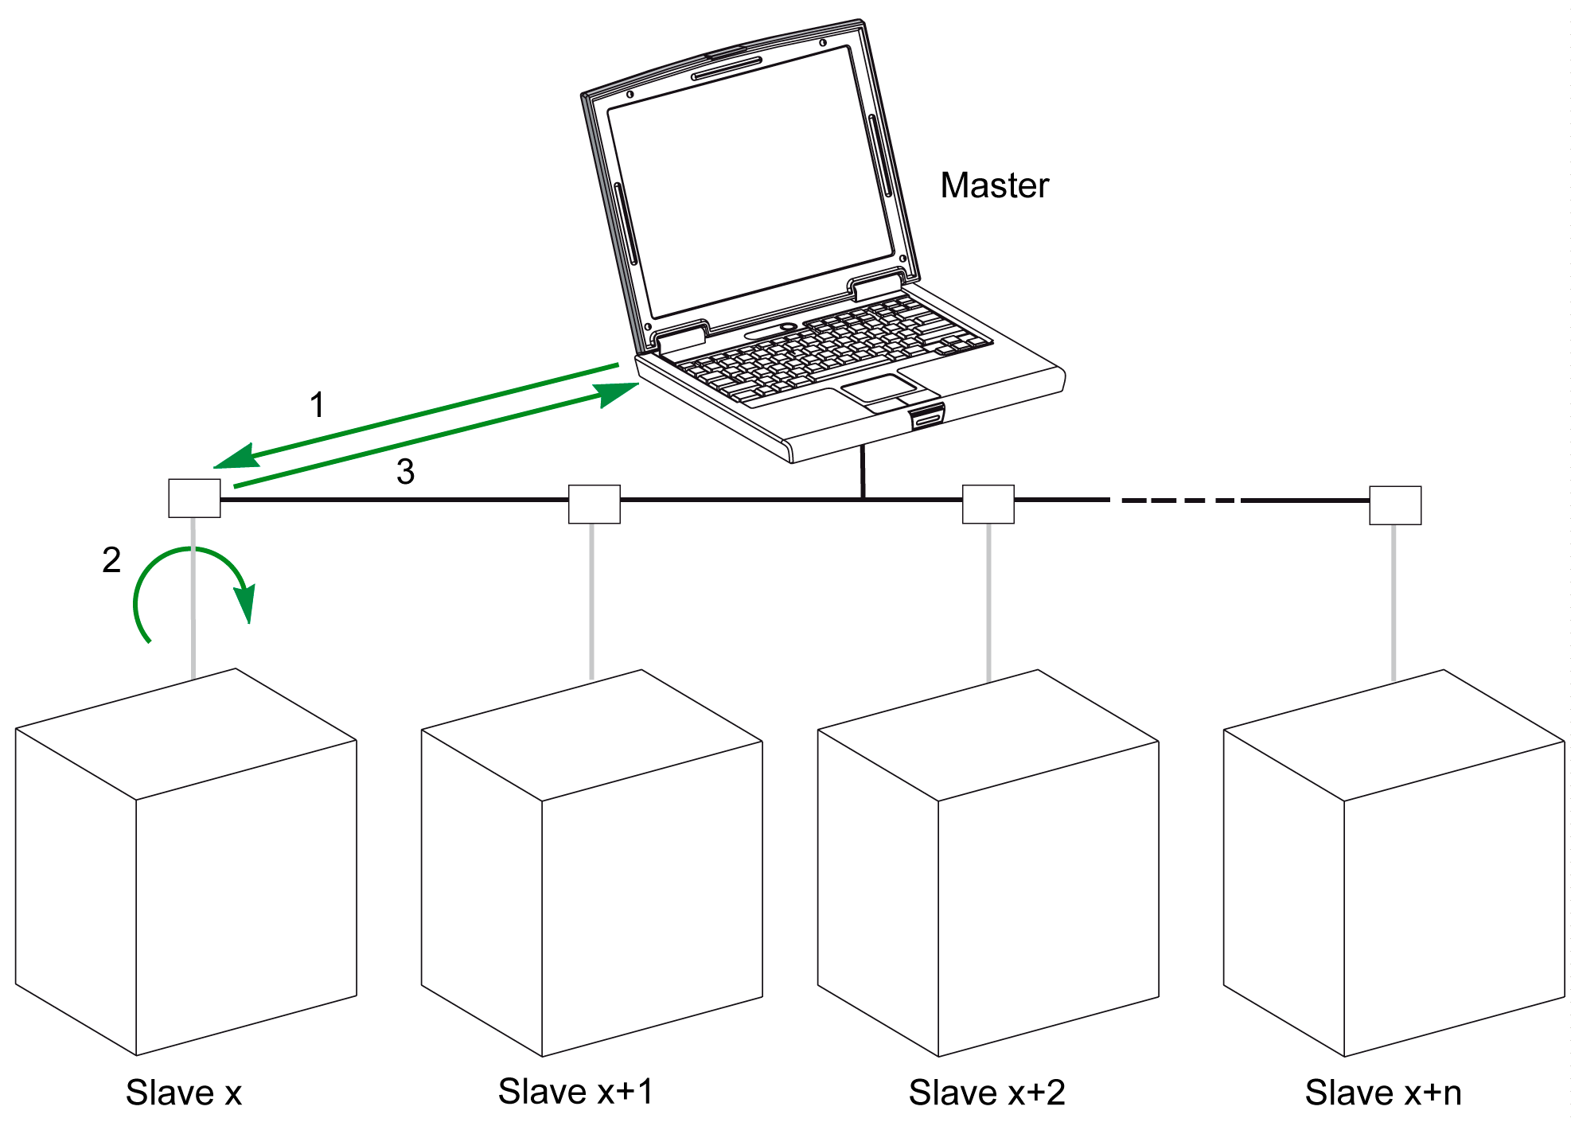
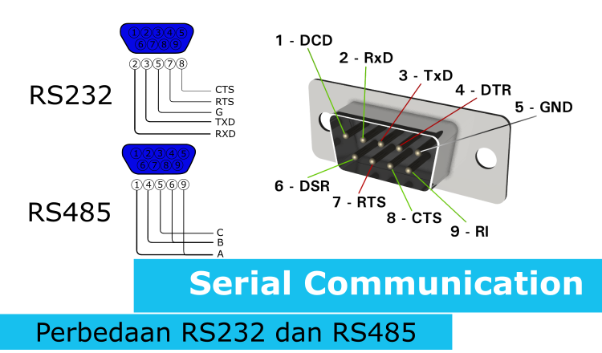
Concept
Types of Modbus
SCADA (Supervisory Control and Data Acquisition) It’s a type of ICS (Industrial Control System)
Master-Slave (Request-Response)
Image references:
[1]https://lieneticjaya.com/wp-content/uploads/2020/07/Serial-Communication-RS232-dan-RS485-750x440.png
[2] http://www.ruekertmielke.com/blog/2017/6/13/scada-system-tlc
[3] https://realpars.com/modbus/
[4] https://product-help.schneider-electric.com/ED/ES_Power/NT-NW_Modbus_IEC_Guide/EDMS/DOCA0054EN/DOCA0054xx/Master_NS_Modbus_Protocol/Master_NS_Modbus_Protocol-2.htm

Slide 6
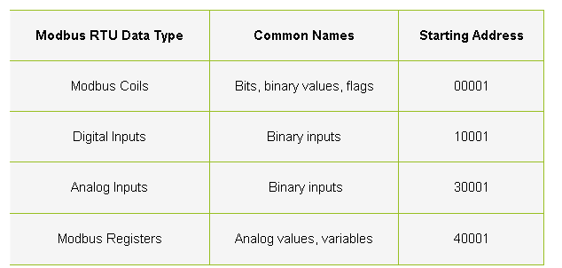
Data Type
Images references:
[1] https://www.dpstele.com/blog/how-to-understand-modbus-rtu.php

Slide 7
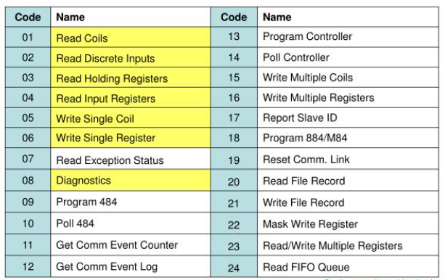
Function Code
Images references:
[1] https://www.slideserve.com/alka/modbus-essential

Slide 8
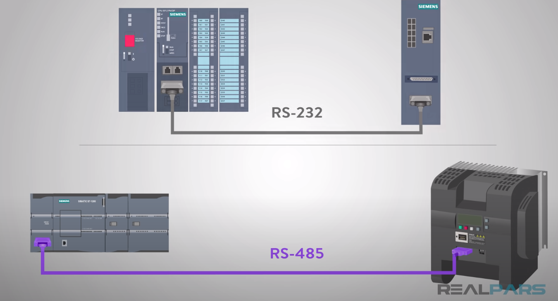
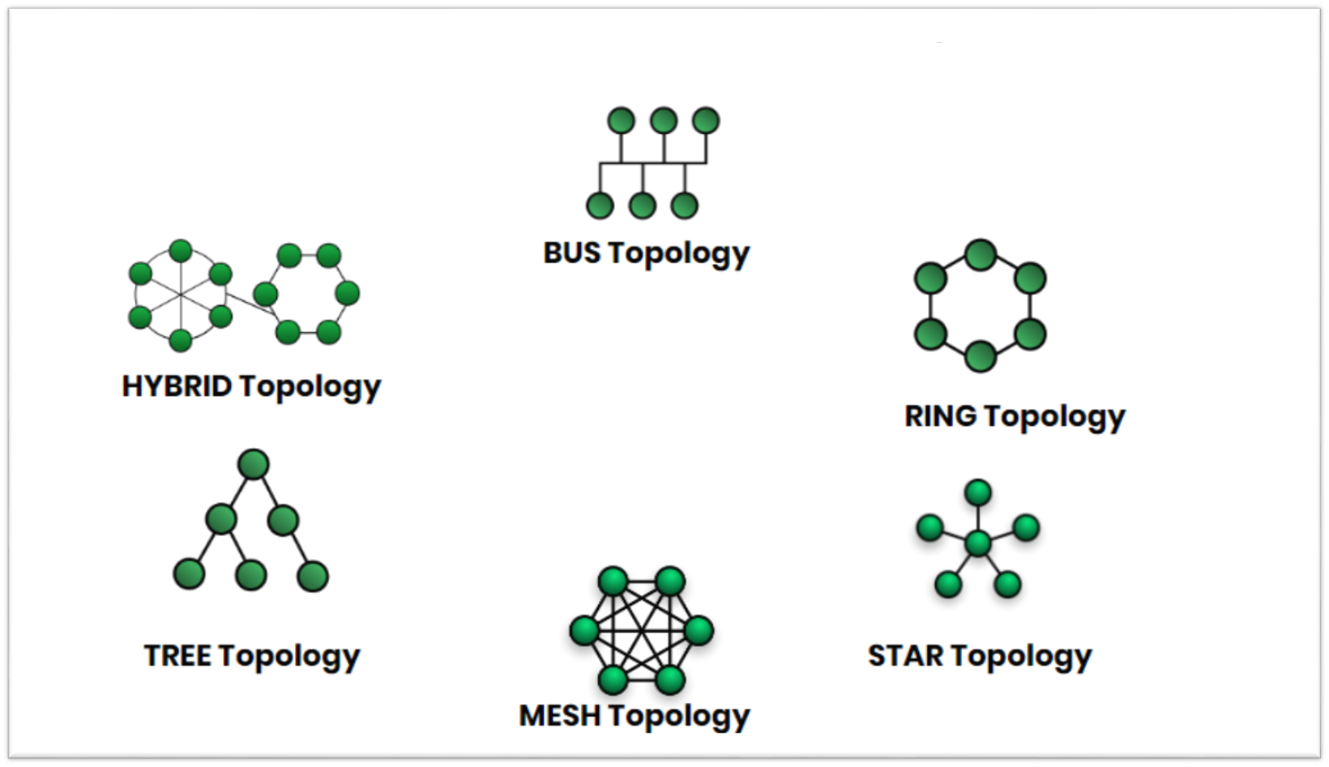
Topology of Modbus
Images references:
[1] https://www.youtube.com/watch?v=3wgKcUDlHuM
[2] https://www.everelettronica.com/de/technologien/ethernet-modbus-tcp-ip
[3] https://www.edupointbd.com/network-topology-ev/

Slide 9
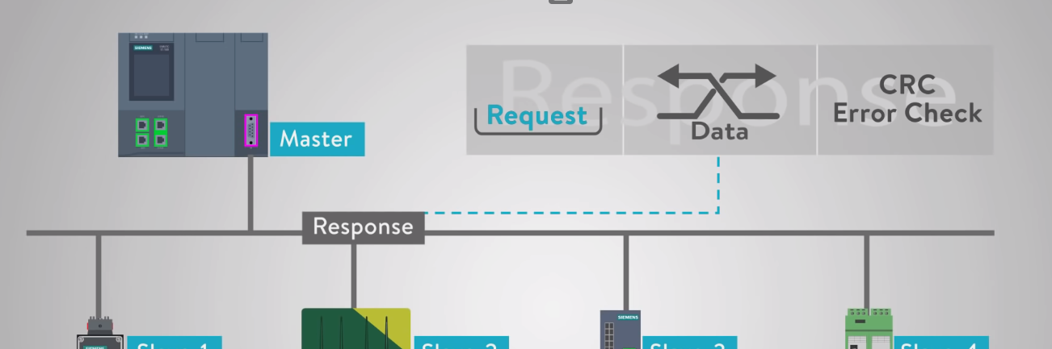
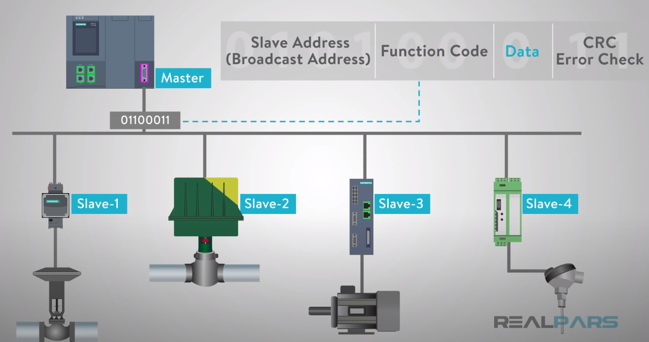
Applications of Modbus
Images references:
[1] https://www.youtube.com/watch?v=txi2p5_OjKU

Slide 10
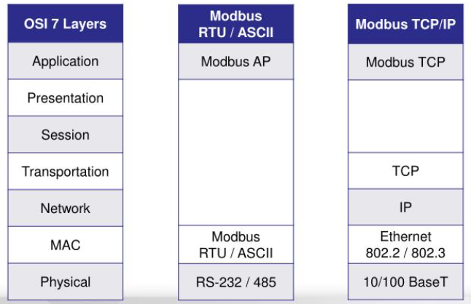
OSI vs Modbus
Images references:
[1] https://www.slideserve.com/alka/modbus-essential

Slide 11
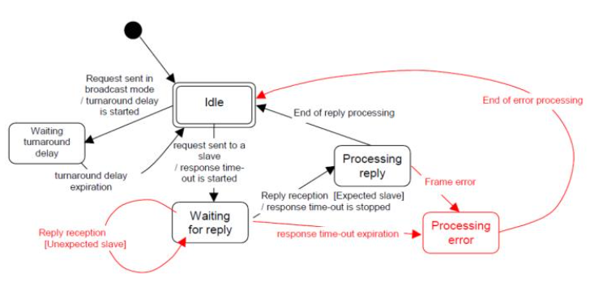
State Machine
Images references:
[1] https://www.slideserve.com/alka/modbus-essential

Slide 12
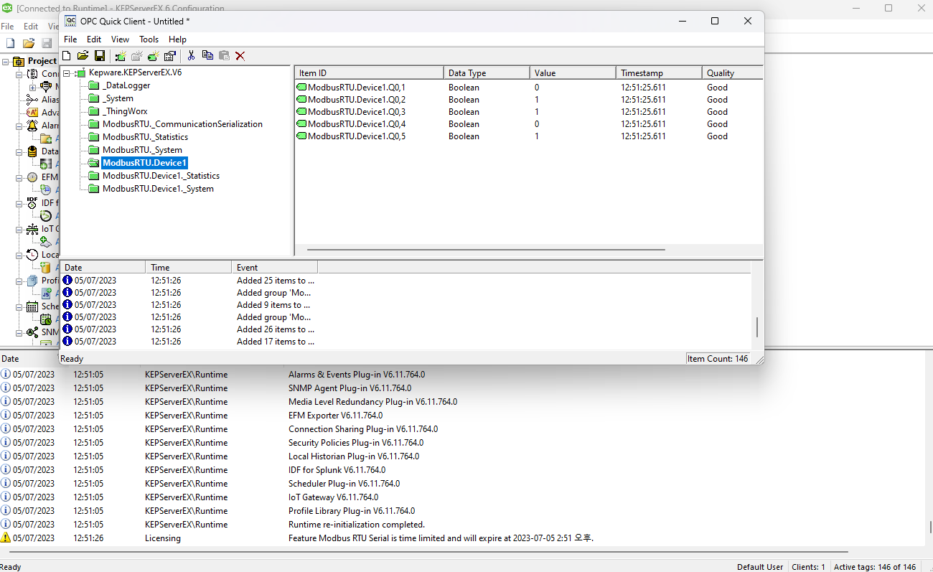
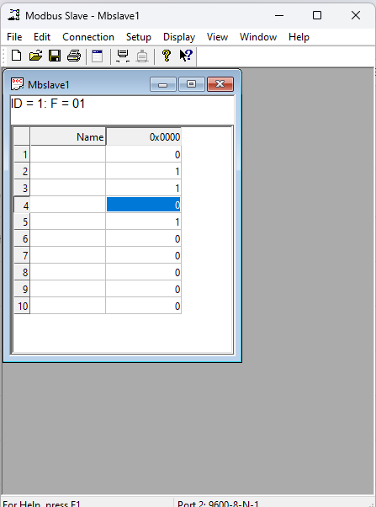
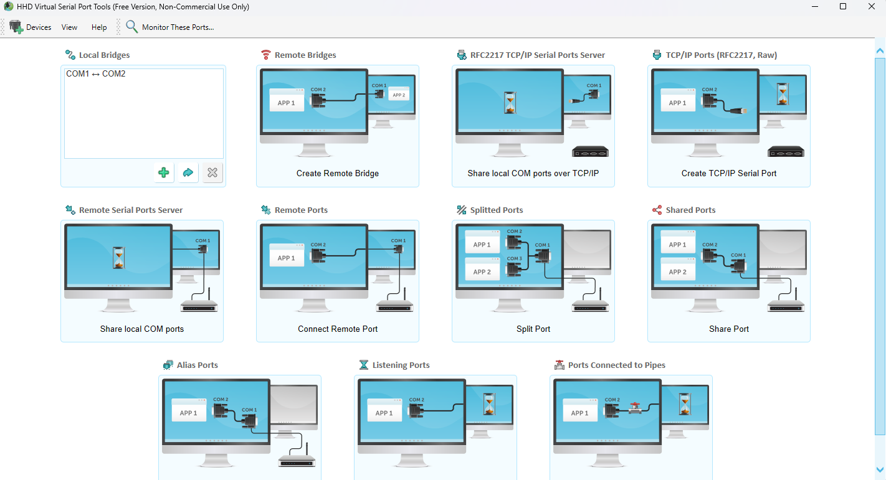
Simulation of Modbus

Slide 13
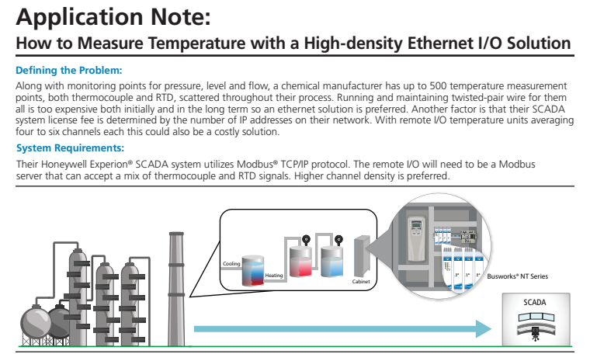
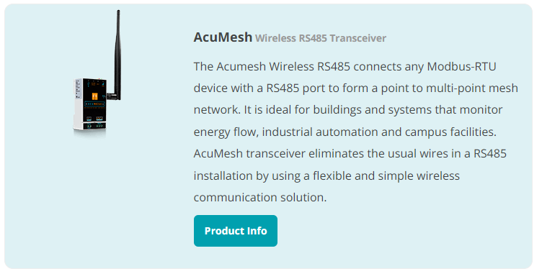
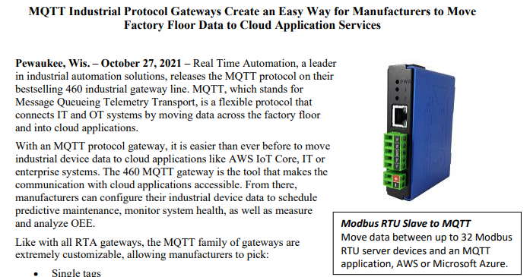
Real-life Applications of Modbus
Images references:
[1] https://modbus.org/member_docs/RTAutomation-10-27-21.pdf
[2] https://www.accuenergy.com/support/reference-directory/wireless-modbus/
[3] https://modbus.org/member_docs/Acromag-How-to-Measure-Temperature-with-a-High-density-Ethernet-IO-Solution-Application-Note.pdf
[4] https://grandcentrix.net/en/products/modbus/

Slide 14
Benefits
Simplicity: easy to understand and implement, wide adoption in various industries.
Open-Source: an open-source protocol, meaning there are no licensing fees to use it (but softwares to facilitate, yes).
Versatility: supports multiple types of data and can be used over both serial and Ethernet connections.
Compatibility: supported by many industrial devices due to its longevity and popularity.

Slide 15
Constraints
Limited Data Types: from 1970s, and the number of data types is limited to those understood by PLCs at that time.
Lack of Discoverability: No standard way exists for a node to find the description of a data object, for example, to learn that a register value represents a temperature between 30 and 175 degrees.
Bandwidth: The client node must routinely poll each field device and look for changes in the data, which can consume significant bandwidth.
Security: Modbus protocol itself provides no security against unauthorized commands or interception of data.
Addressing: Modbus is restricted to addressing 247 devices on one data link, which limits the number of field devices that may be connected to a parent station.

